Slide 1
IICT Project
Team members:
Rafay Mirza
Ammen Qureshi
Saad Bin Saeed

Slide 2
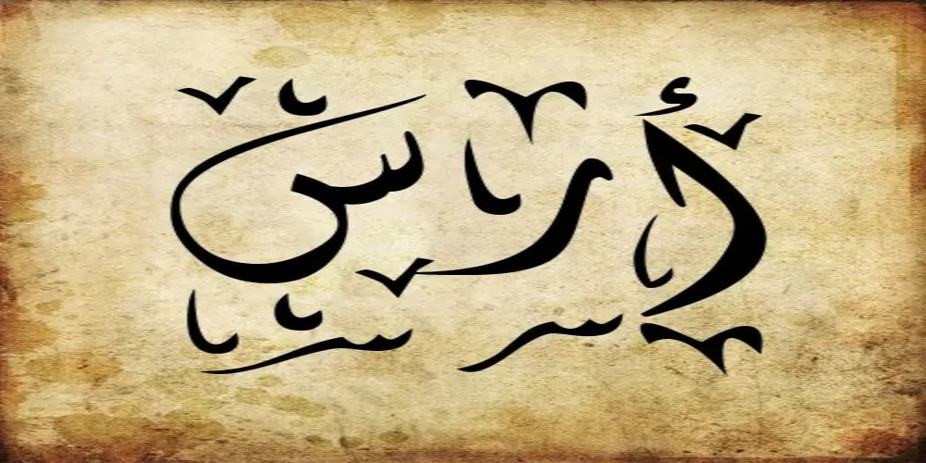

Slide 3
Ecommerce Website
Clothing website: An innovative approach

Slide 4
Name
The name comes from the initials of the masterminds behind this projects Ammen, Rafay and Saad.

Slide 5
Motivation:
To revive our Pakistani culture with a touch of modernity.

Slide 6
Purpose
Make clothing cheap
Available for all people
Make online shopping easy
Friendly generic interface for all companies to implement

Slide 7
Target audience
Every Culture(Celebrating every ethnic group):
As we offer a variety of clothing for everyone to delve into the Pakistani Culture.

Slide 8
Theme
The burnt background colors and themes
symbolize our aged culture rich in history and tradition the peculiar urdu naming all translates into the beautiful symphony of this country.

Slide 9
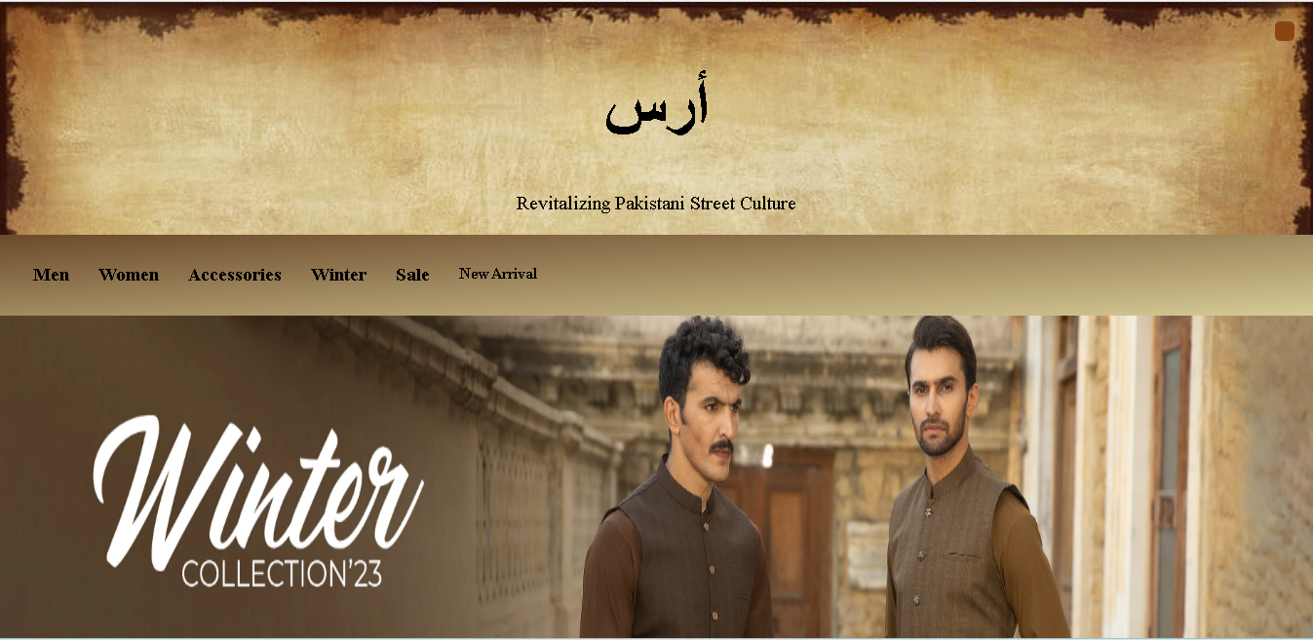
Welcome Page
The welcome page is a homage to the rich Pakistani heritage.

Slide 10
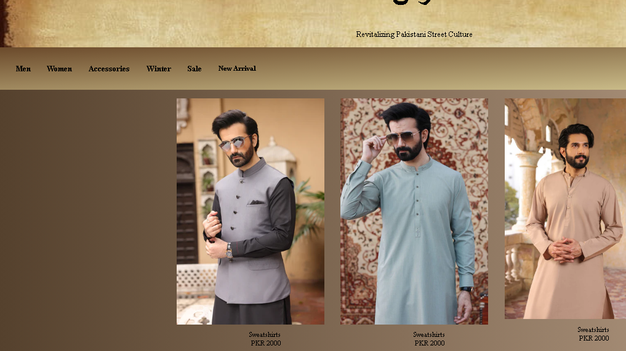
Men section
Offer cultural men clothes

Slide 11
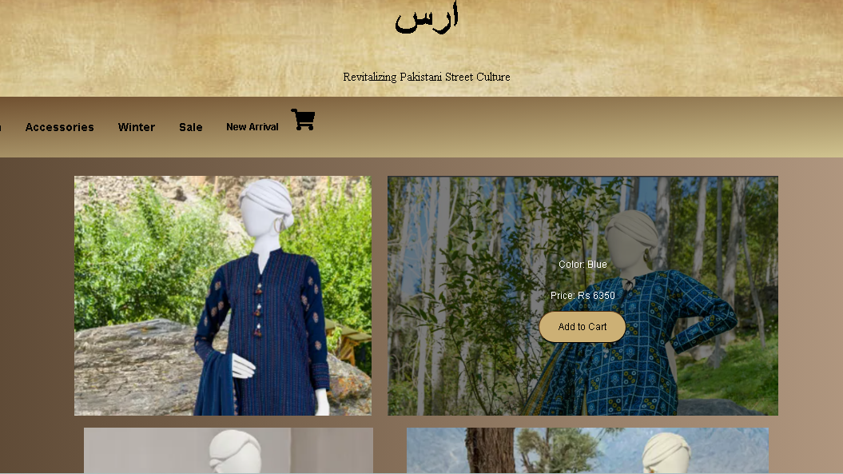
Women section
Cultural women clothes

Slide 12
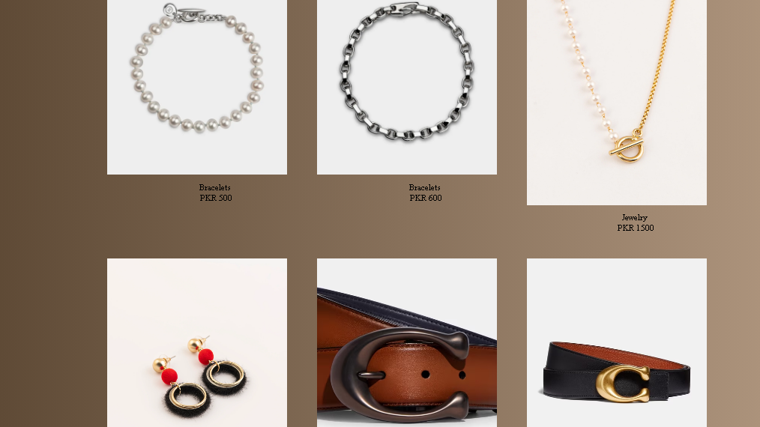
Accessories
Offer female accessories

Slide 13
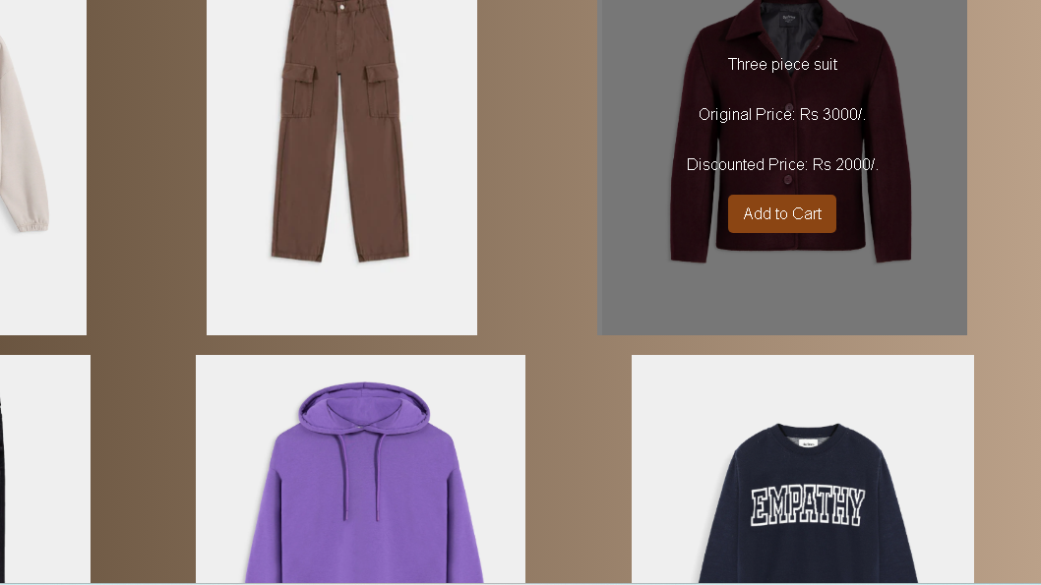
Sale page
This page is a chance for users to steal favorite pieces at a discounted price

Slide 14
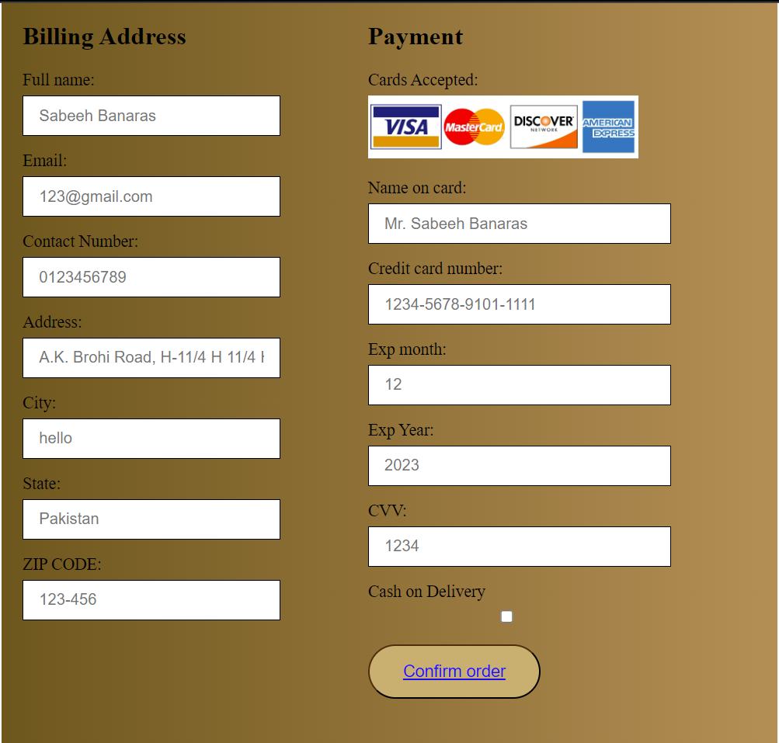
Check-out

Slide 15
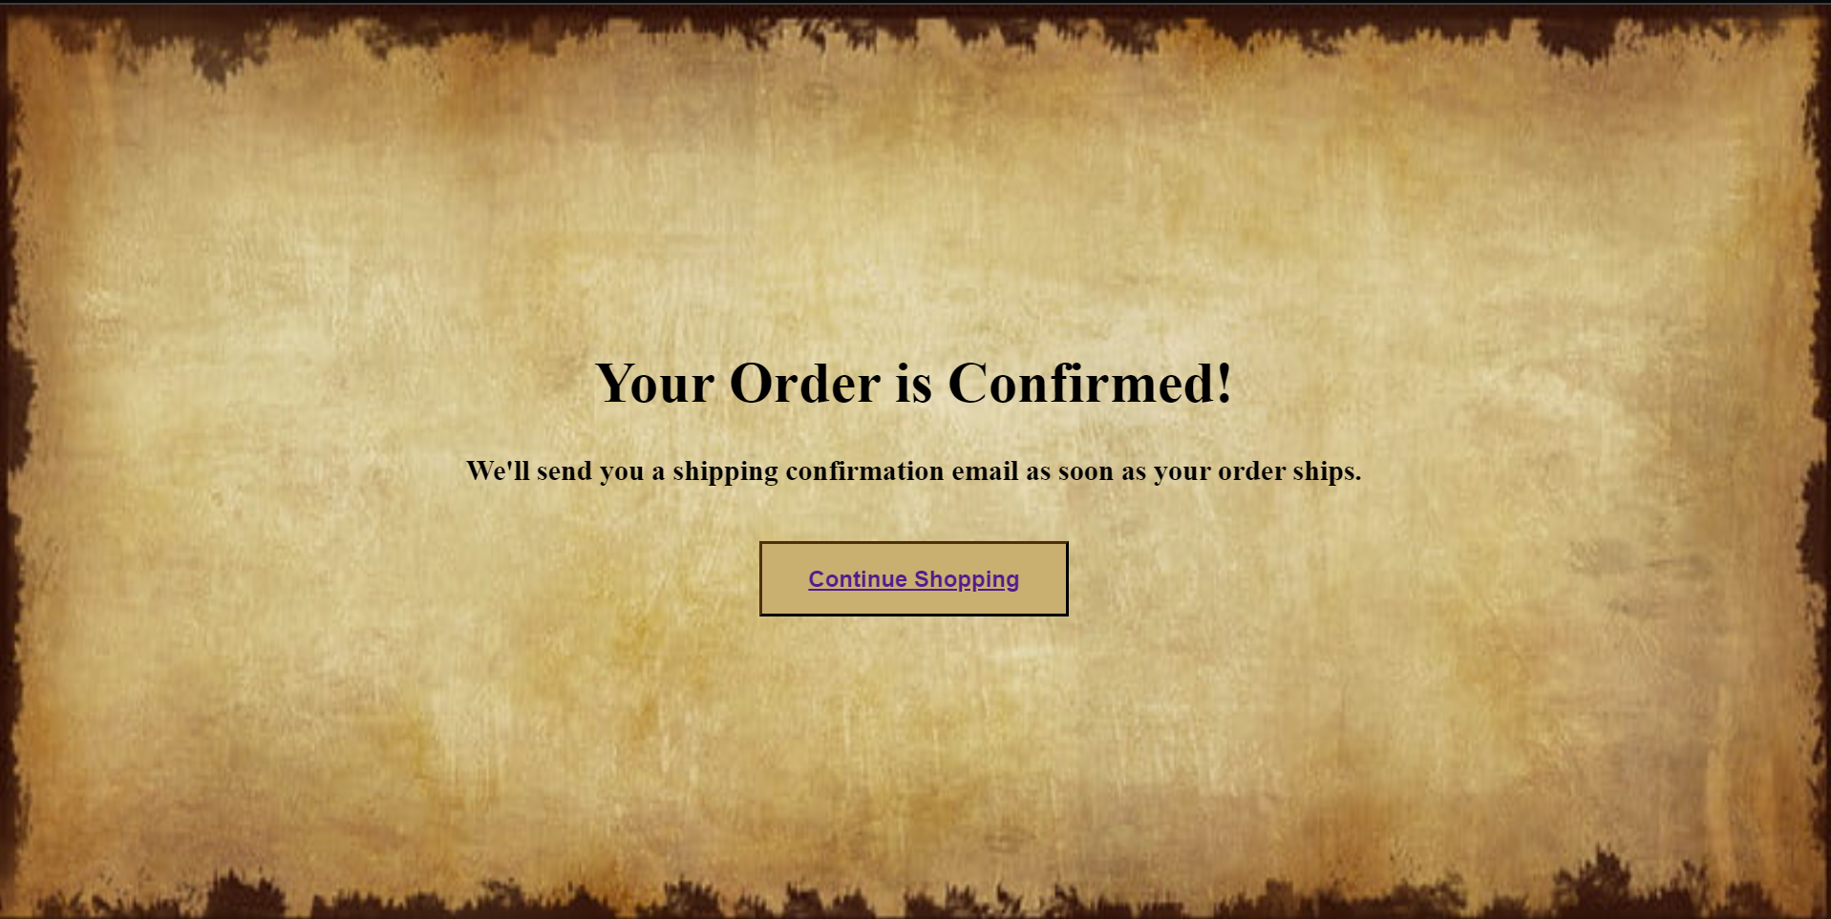
Thank You Page

Slide 16
Functionality
Log-in
Add items to your cart
Check-out

Slide 17
Responsiveness
Adds items to the cart.
Responsive with different screens

Slide 18
Future direction
Give brands a new and rich interface to better represent Pakistan in every domain of fashion.

Slide 19
Conclusion
آ ر س is more than a clothing brand; it's a cultural journey, and its website is the immersive gateway to this captivating adventure.

